Slide 1
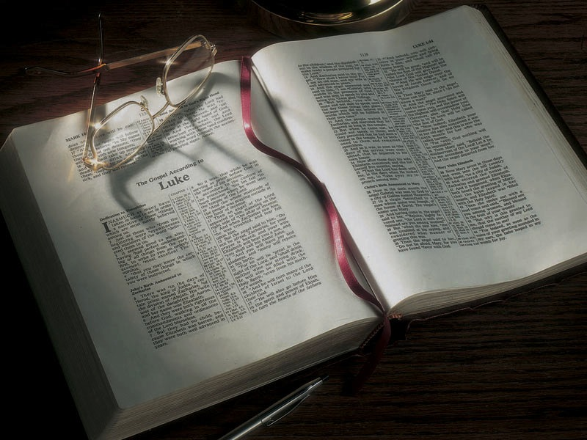

Slide 2
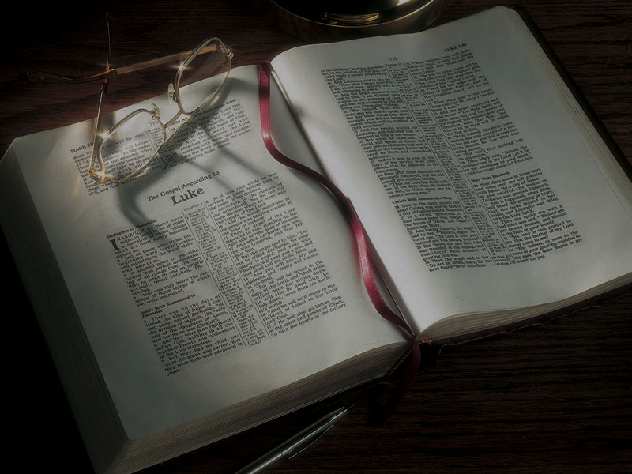
The Gospels
Nicodemus Comes to See Jesus, Jesus Tells Him He Must Be Born Again

Slide 3
John 2:23-3:21
2:23 Now when He was in Jerusalem at the Passover, during the feast, many believed in His name when they saw the signs which He did.
24 But Jesus did not commit Himself to them, because He knew all men,
25 and had no need that anyone should testify of man, for He knew what was in man.

Slide 4
John 2:23-3:21
3:1 There was a man of the Pharisees named Nicodemus, a ruler of the Jews.

Slide 5
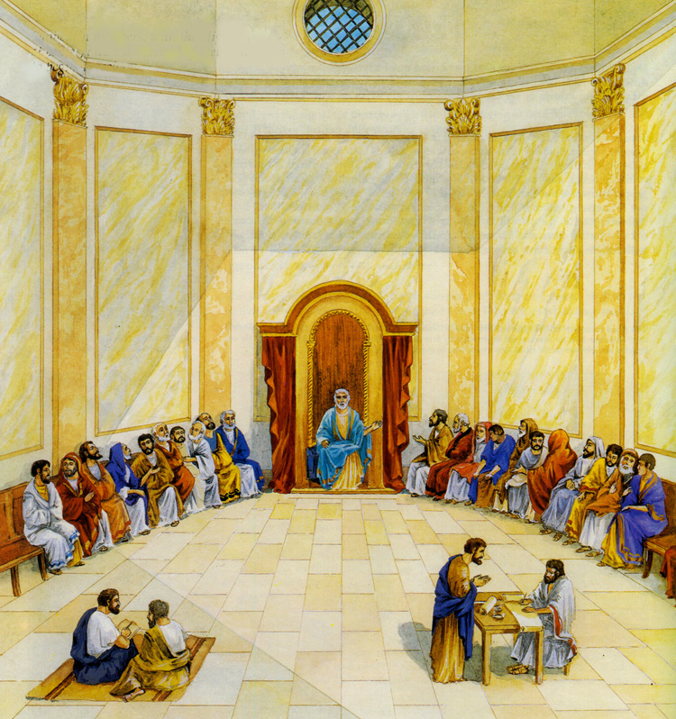

Slide 6
John 7:47-52
47 Then the Pharisees answered them, “Are you also deceived?
48 “Have any of the rulers or the Pharisees believed in Him?
49 “But this crowd that does not know the law is accursed.”

Slide 7
John 7:47-52
50 Nicodemus (he who came to Jesus by night, being one of them) said to them,
51 “Does our law judge a man before it hears him and knows what he is doing?”
52 They answered and said to him, “Are you also from Galilee? Search and look, for no prophet has arisen out of Galilee.”

Slide 8
John 19:38-42
38 After this, Joseph of Arimathea, being a disciple of Jesus, but secretly, for fear of the Jews, asked Pilate that he might take away the body of Jesus; and Pilate gave him permission. So he came and took the body of Jesus.
39 And Nicodemus, who at first came to Jesus by night, also came, bringing a mixture of myrrh and aloes, about a hundred pounds.

Slide 9
John 19:38-42
40 Then they took the body of Jesus, and bound it in strips of linen with the spices, as the custom of the Jews is to bury.
41 Now in the place where He was crucified there was a garden, and in the garden a new tomb in which no one had yet been laid.
42 So there they laid Jesus, because of the Jews’ Preparation Day, for the tomb was nearby.

Slide 10
John 2:23-3:21
3:1 There was a man of the Pharisees named Nicodemus, a ruler of the Jews.
2 This man came to Jesus by night and said to Him, “Rabbi, we know that You are a teacher come from God; for no one can do these signs that You do unless God is with him.”
3 Jesus answered and said to him, “Most assuredly, I say to you, unless one is born again, he cannot see the kingdom of God.”

Slide 11
John 2:23-3:21
4 Nicodemus said to Him, “How can a man be born when he is old? Can he enter a second time into his mother’s womb and be born?”
5 Jesus answered, “Most assuredly, I say to you, unless one is born of water and the Spirit, he cannot enter the kingdom of God.

Slide 12
Romans 6:3-4
3 Or do you not know that as many of us as were baptized into Christ Jesus were baptized into His death?
4 Therefore we were buried with Him through baptism into death, that just as Christ was raised from the dead by the glory of the Father, even so we also should walk in newness of life.

Slide 13
Colossians 2:12-13
12 buried with Him in baptism, in which you also were raised with Him through faith in the working of God, who raised Him from the dead.
13 And you, being dead in your trespasses and the uncircumcision of your flesh, He has made alive together with Him . . .

Slide 14
Mark 16:16
16 He who believes and is baptized will be saved; but he who does not believe will be condemned.

Slide 15
John 2:23-3:21
4 Nicodemus said to Him, “How can a man be born when he is old? Can he enter a second time into his mother’s womb and be born?”
5 Jesus answered, “Most assuredly, I say to you, unless one is born of water and the Spirit, he cannot enter the kingdom of God.
6 “That which is born of the flesh is flesh, and that which is born of the Spirit is spirit.

Slide 16
1 Corinthians 15:50-54
50 Now this I say, brethren, that flesh and blood cannot inherit the kingdom of God; nor does corruption inherit incorruption.
51 Behold, I tell you a mystery: We shall not all sleep, but we shall all be changed—
52 in a moment, in the twinkling of an eye, at the last trumpet. For the trumpet will sound, and the dead will be raised incorruptible, and we shall be changed.

Slide 17
1 Corinthians 15:50-54
53 For this corruptible must put on incorruption, and this mortal must put on immortality.
54 So when this corruptible has put on incorruption, and this mortal has put on immortality, then shall be brought to pass the saying that is written: “Death is swallowed up in victory.”

Slide 18
1 Corinthians 15:39-49
35 But someone may ask, “How are the dead raised? With what kind of body will they come?”
…
39 All flesh is not the same: Men have one kind of flesh, animals have another, birds another and fish another.
40 There are also heavenly bodies and there are earthly bodies; but the splendour of the heavenly bodies is one kind, and the splendour of the earthly bodies is another.

Slide 19
1 Corinthians 15:39-49
41 The sun has one kind of splendour, the moon another and the stars another; and star differs from star in splendour.
42 So will it be with the resurrection of the dead. The body that is sown is perishable, it is raised imperishable;
43 it is sown in dishonour, it is raised in glory; it is sown in weakness, it is raised in power;
44 it is sown a natural body, it is raised a spiritual body. If there is a natural body, there is also a spiritual body.

Slide 20
1 Corinthians 15:39-49
45 So it is written: “The first man Adam became a living being”; the last Adam, a life-giving spirit.
46 The spiritual did not come first, but the natural, and after that the spiritual.
47 The first man was of the dust of the earth, the second man from heaven.
48 As was the earthly man, so are those who are of the earth; and as is the man from heaven, so also are those who are of heaven.

Slide 21
1 Corinthians 15:39-49
49 And just as we have borne the likeness of the earthly man, so shall we bear the likeness of the man from heaven.

Slide 22
John 2:23-3:21
6 “That which is born of the flesh is flesh, and that which is born of the Spirit is spirit.
7 “Do not marvel that I said to you, ‘You must be born again.’
8 “The wind blows where it wishes, and you hear the sound of it, but cannot tell where it comes from and where it goes. So is everyone who is born of the Spirit.”
9 Nicodemus answered and said to Him, “How can these things be?”

Slide 23
John 2:23-3:21
10 Jesus answered and said to him, “Are you the teacher of Israel, and do not know these things?
11 “Most assuredly, I say to you, We speak what We know and testify what We have seen, and you do not receive Our witness.
12 “If I have told you earthly things and you do not believe, how will you believe if I tell you heavenly things?
13 “No one has ascended to heaven but He who came down from heaven, that is, the Son of Man who is in heaven.

Slide 24
John 2:23-3:21
10 Jesus answered and said to him, “Are you the teacher of Israel, and do not know these things?
11 “Most assuredly, I say to you, We speak what We know and testify what We have seen, and you do not receive Our witness.
12 “If I have told you earthly things and you do not believe, how will you believe if I tell you heavenly things?
13 “No one has ascended to heaven but He who came down from heaven” (that is, the Son of Man who is in heaven).

Slide 25
Acts 2:29, 34
29 Men and brethren, let me speak freely to you of the patriarch David, that he is both dead and buried, and his tomb is with us to this day . . .
34 For David did not ascend into the heavens . . .

Slide 26
Acts 2:29, 34
29 Men and brethren, let me speak freely to you of the patriarch David, that he is both dead and buried, and his tomb is with us to this day . . .
34 For David did not ascend into the heavens . . .
Acts 13:22
22 And when He [God] had removed him [Saul], He raised up for them David as king, to whom also He gave testimony and said, “I have found David the son of Jesse, a man after My own heart, who will do all My will.”

Slide 27
John 2:23-3:21
14 “And as Moses lifted up the serpent in the wilderness, even so must the Son of Man be lifted up,

Slide 28
Numbers 21:4-9
4 Then they [the Israelites] journeyed from Mount Hor by the Way of the Red Sea, to go around the land of Edom; and the soul of the people became very discouraged on the way.
5 And the people spoke against God and against Moses: “Why have you brought us up out of Egypt to die in the wilderness? For there is no food and no water, and our soul loathes this worthless bread.”
6 So the LORD sent fiery serpents among the people, and they bit the people; and many of the people of Israel died.

Slide 29
Numbers 21:4-9
7 Therefore the people came to Moses, and said, “We have sinned, for we have spoken against the LORD and against you; pray to the LORD that He take away the serpents from us.” So Moses prayed for the people.
8 Then the LORD said to Moses, “Make a fiery serpent, and set it on a pole; and it shall be that everyone who is bitten, when he looks at it, shall live.”

Slide 30
Numbers 21:4-9
9 So Moses made a bronze serpent, and put it on a pole; and so it was, if a serpent had bitten anyone, when he looked at the bronze serpent, he lived.

Slide 31
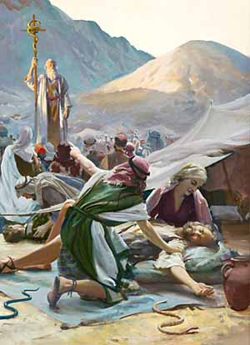
Bronze serpent

Slide 32
John 2:23-3:21
14 “And as Moses lifted up the serpent in the wilderness, even so must the Son of Man be lifted up,
15 “that whoever believes in Him should not perish but have eternal life.
16 “For God so loved the world that He gave His only begotten Son, that whoever believes in Him should not perish but have everlasting life.
17 “For God did not send His Son into the world to condemn the world, but that the world through Him might be saved.

Slide 33
James 2:19-22
19 You believe that there is one God. You do well. Even the demons believe—and tremble!
20 But do you want to know, O foolish man, that faith without works is dead?
21 Was not Abraham our father justified by works when he offered Isaac his son on the altar?
22 Do you see that faith was working together with his works, and by works faith was made perfect?

Slide 34
James 2:19-22
23 And the Scripture was fulfilled which says, “Abraham believed God, and it was accounted to him for righteousness.” And he was called the friend of God.
24 You see then that a man is justified by works, and not by faith only.

Slide 35
Matthew 7:21
21 “Not everyone who says to Me, ‘Lord, Lord,’ shall enter the kingdom of heaven, but he who does the will of My Father in heaven.”

Slide 36
Matthew 19:16-17
16 Now behold, one came and said to Him, “Good Teacher, what good thing shall I do that I may have eternal life?”
17 So He said to him, “Why do you call Me good? No one is good but One, that is, God. But if you want to enter into life, keep the commandments.”

Slide 37
Mark 16:16
16 “He who believes and is baptized will be saved; but he who does not believe will be condemned.”

Slide 38
Matthew 10:22
22 He who endures to the end will be saved.

Slide 39
John 2:23-3:21
16 “For God so loved the world that He gave His only begotten Son, that whoever believes in Him should not perish but have everlasting life.
17 “For God did not send His Son into the world to condemn the world, but that the world through Him might be saved.

Slide 40
Four key questions for us:
What does this teach us about the nature and character of God?
What does this teach us about the way God interacts with His people and mankind?
What does this mean for your relationship with God the Father and Jesus Christ?
What does this teach us about Satan, the adversary of God and mankind?

Slide 41
John 2:23-3:21
16 “For God so loved the world that He gave His only begotten Son, that whoever believes in Him should not perish but have everlasting life.
17 “For God did not send His Son into the world to condemn the world, but that the world through Him might be saved.

Slide 42
John 2:23-3:21
16 “For God so loved the world that He gave His only begotten Son, that whoever believes in Him should not perish but have everlasting life.
17 “For God did not send His Son into the world to condemn the world, but that the world through Him might be saved.

Slide 43
1 John 4:8, 16
8 He who does not love does not know God, for God is love.
16 God is love, and he who abides in love abides in God, and God in him.

Slide 44
Revelation 21:7
7 He who overcomes shall inherit all things, and I will be his God and he shall be My son.

Slide 45
Hebrews 2:6-8 (Psalm 8:4-6)
6 But one testified in a certain place, saying: “What is man that You are mindful of him, or the son of man that You take care of him?
7 You have made him a little lower than the angels; You have crowned him with glory and honor, and set him over the works of Your hands.
8 You have put all things in subjection under his feet.” For in that He put all in subjection under him, He left nothing that is not put under him. But now we do not yet see all things put under him.

Slide 46
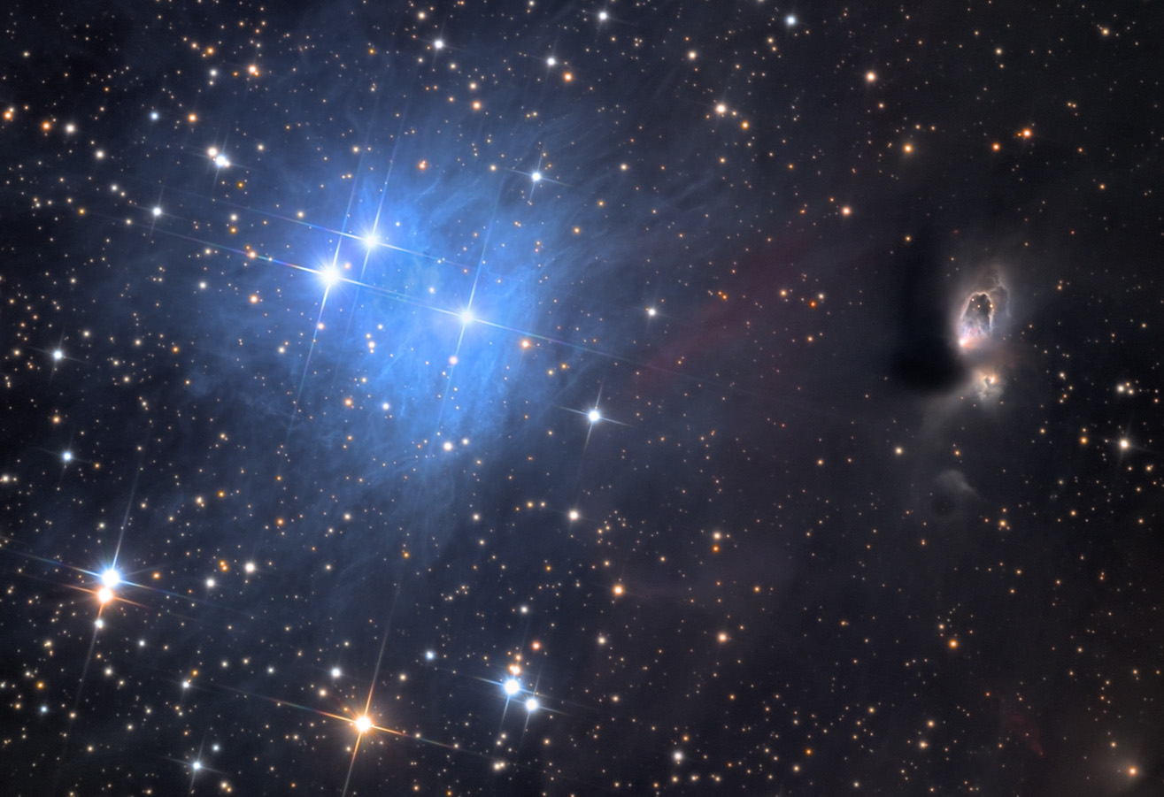

Slide 47
Deuteronomy 4:19
19 . . . the sun, the moon, and the stars, all the host of heaven . . . which the LORD your God has given to all the peoples under the whole heaven as a heritage.

Slide 48
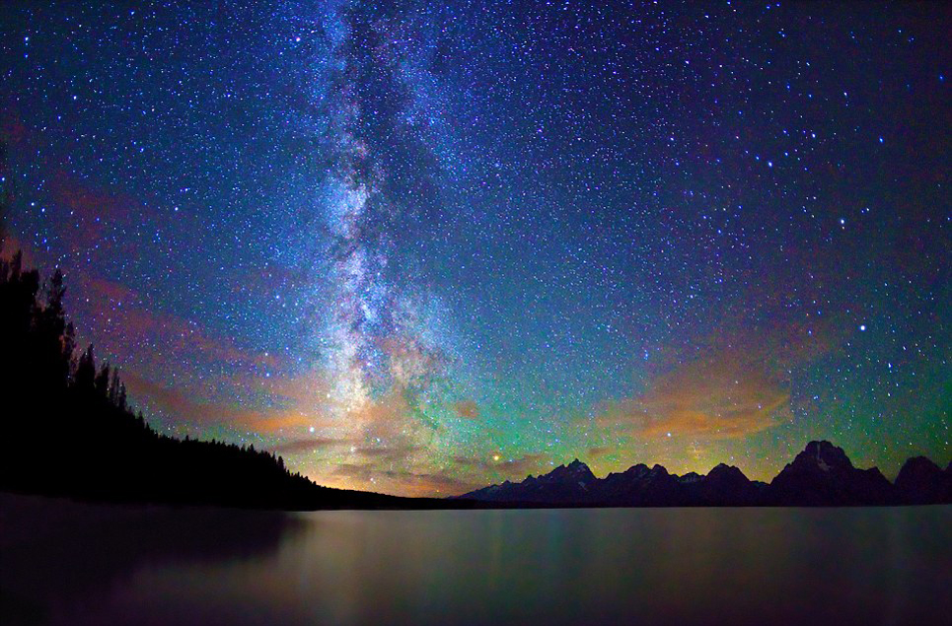

Slide 49
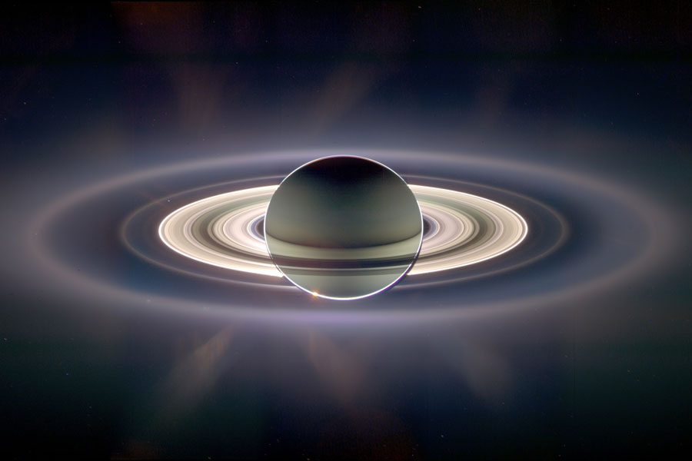

Slide 50
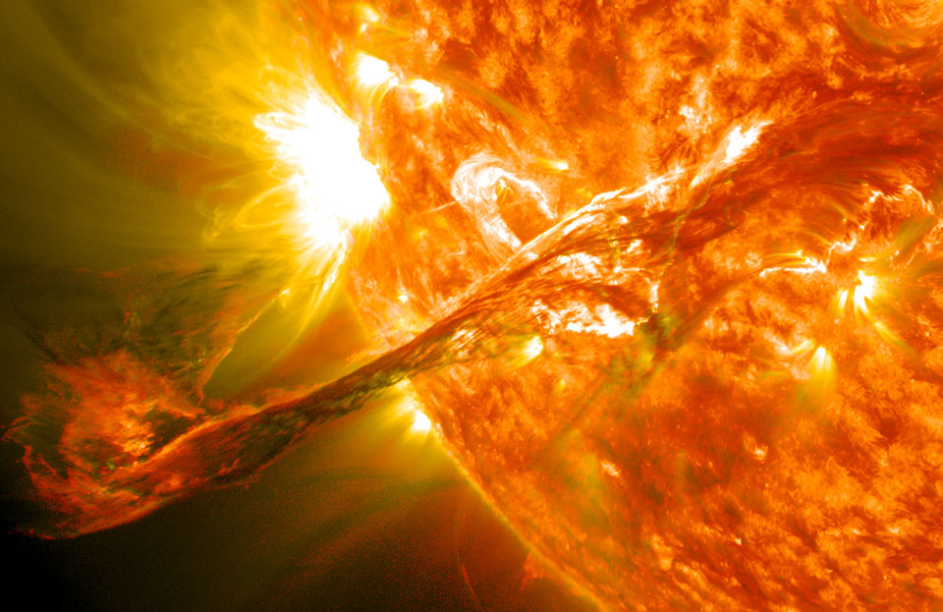

Slide 51
Philippians 2:5-8 (ESV)
5 Have this mind among yourselves, which is yours in Christ Jesus,
6 who, though he was in the form of God, did not count equality with God a thing to be grasped,
7 but emptied himself, by taking the form of a servant, being born in the likeness of men.
8 And being found in human form, he humbled himself by becoming obedient to the point of death, even death on a cross.

Slide 52
John 2:23-3:21
16 “For God so loved the world that He gave His only begotten Son, that whoever believes in Him should not perish but have everlasting life.
17 “For God did not send His Son into the world to condemn the world, but that the world through Him might be saved.

Slide 53
John 2:23-3:21
18 “He who believes in Him is not condemned; but he who does not believe is condemned already, because he has not believed in the name of the only begotten Son of God.
19 “And this is the condemnation, that the light has come into the world, and men loved darkness rather than light, because their deeds were evil.

Slide 54
John 2:23-3:21
20 “For everyone practicing evil hates the light and does not come to the light, lest his deeds should be exposed.
21 “But he who does the truth comes to the light, that his deeds may be clearly seen, that they have been done in God.”

